Slide 1
FINAL EXAM
.

Slide 2
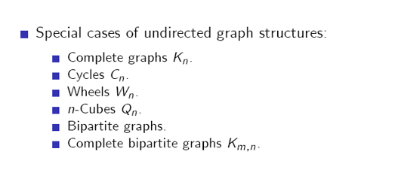

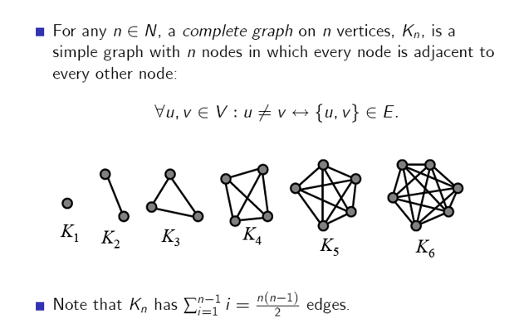

Slide 3
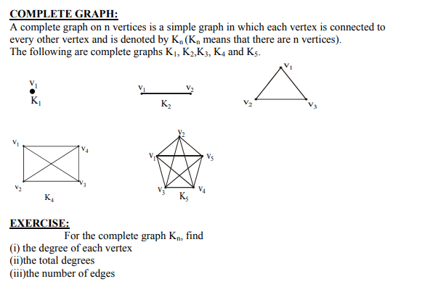


Slide 4
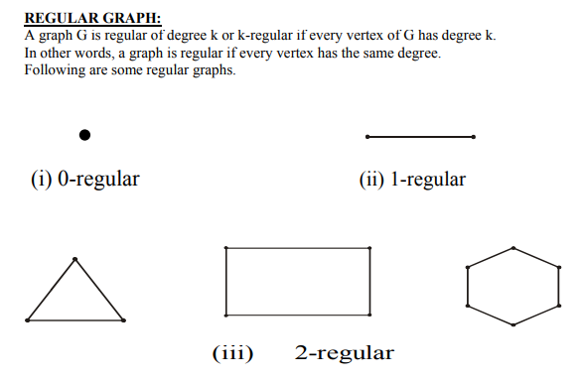
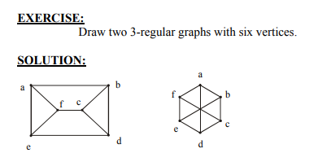

Slide 5
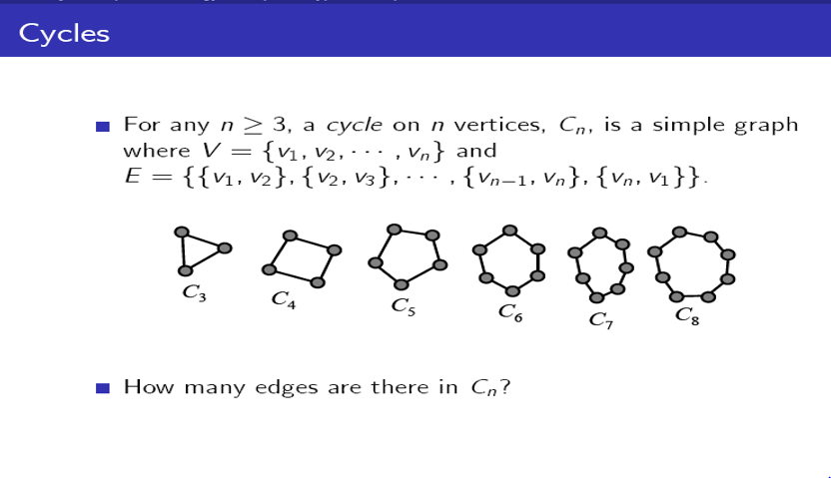
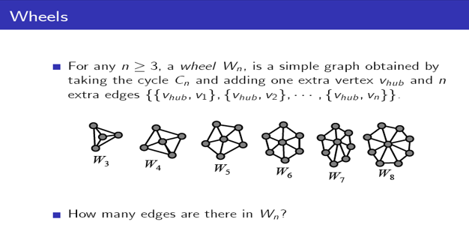

Slide 6
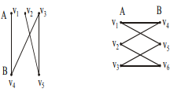
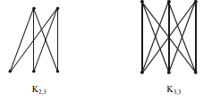
BIPARTITE GRAPH:
A bipartite graph G is a simple graph whose vertex set can be partitioned into two mutually disjoint non empty subsets A and B such that the vertices in A may be connected to vertices in B,
but no vertices in A are connected to vertices in A and no vertices in B are connected to vertices in B.
COMPLETE BIPARTITE GRAPH:
A complete bipartite graph on (m+n) vertices denoted Km,n is a simple graph whose
vertex set can be partitioned into two mutually disjoint non empty subsets A and B
containing m and n vertices respectively, such that each vertex in set A is connected
(adjacent) to every vertex in set B, but the vertices within a set are not connected

Slide 7
C₅ is a subgraph of K₅
Definition 6. A subgraph of a graph G = (V, E) is a graph H = (W, F) where W ⊆ V and F ⊆ E.
K₅
C₅

Slide 8
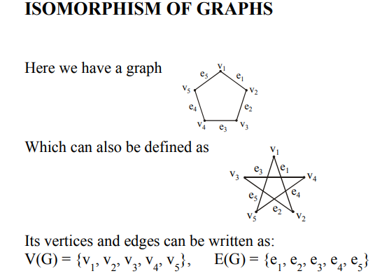
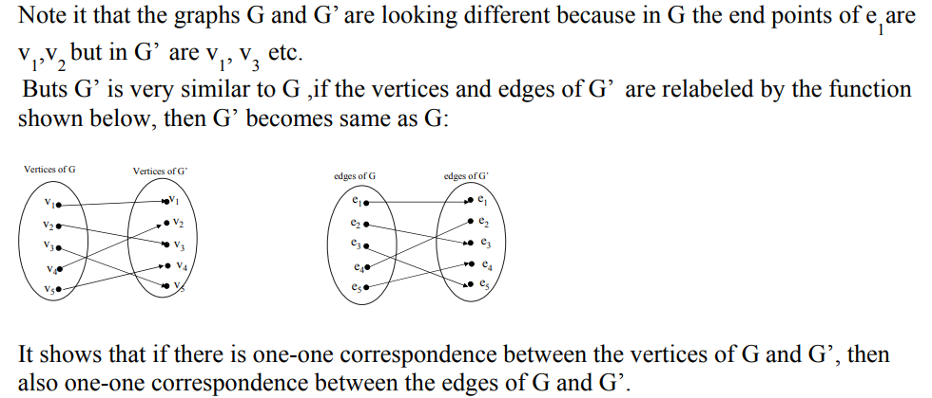
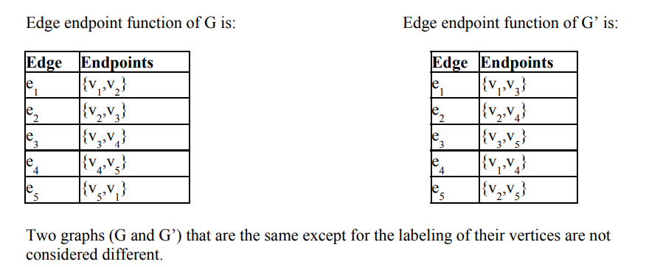

Slide 9
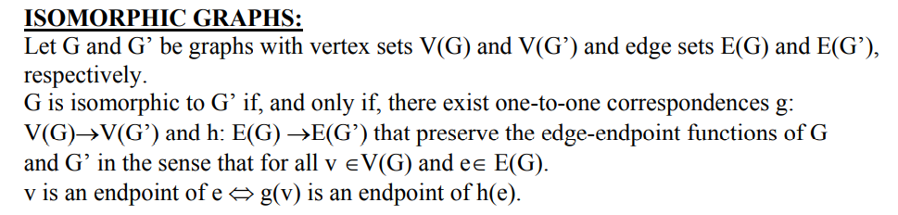
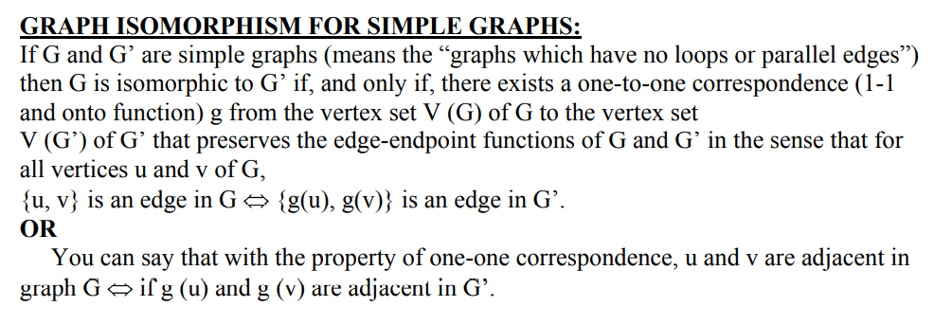

Slide 10
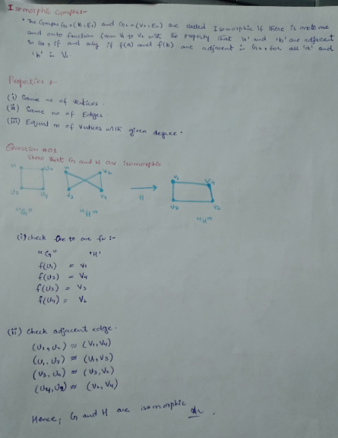
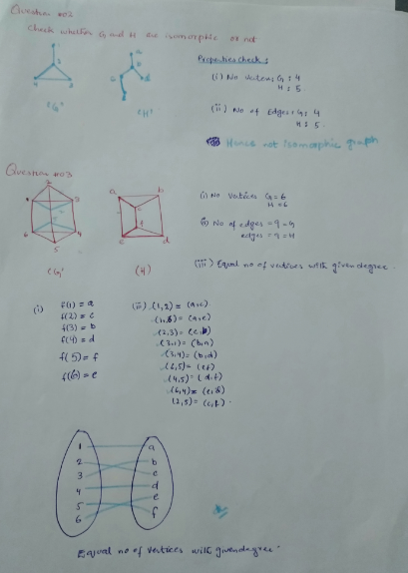

Slide 11
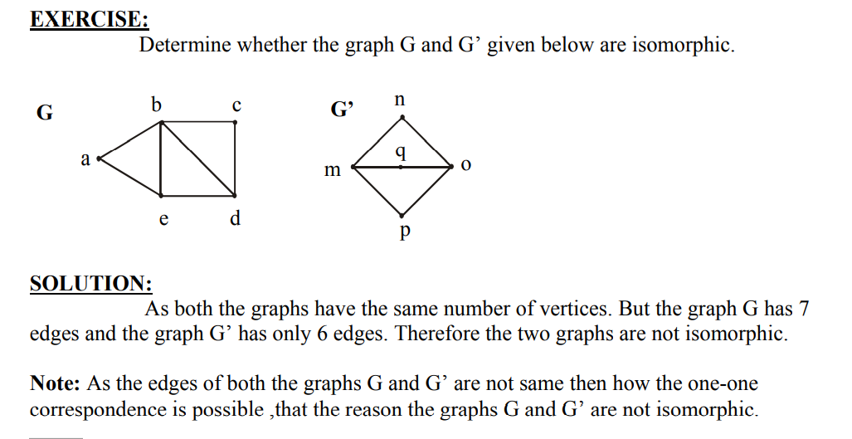

Slide 12



